Slide 1

Department of Computer Engineering
VEHICLE PARKING MANAGEMENT SYSTEM
Group ID: 21
Project Guide: Prof. P. P. Shinde
Project Group Members: Danish Khan
Darshan Chavan
Himanshu Baviskar
Rahul Pardeshi

Slide 2
Abstract
The number of vehicles is increasing exponentially day-by-day, due to which automatic vehicles identification/monitoring system is being paid significance all over the world. Different countries in the world are using various types of automatic systems for traffic control, vehicles identification. Number plate recognition (NPR) is an authentic-time embedded system which frequently recognition the number plate of vehicle. Pervious systems are using only for identification of vehicle. The proposed system is by using the RFID (Radio Frequency Identification) for the identification and verification of vehicle.

Slide 3
Introduction
To built a system which will automatically sense the entry and exit of vehicles.
Monitoring can be done easily administrator can easily generate the reports and verify the owner of the vehicle
Whenever vehicle entered into the campus the in time and the out time is noted automatically by RFID device.

Slide 4
Problem Statement
Creating a computer application which will solve the problems of slot allocation, unidentified vehicle entry and vehicle tracking in the college campus.

Slide 5
Motivation of Project
Our projects plays an important role in various applications such as vehicle monitoring, vehicle management, parking lots access control.
To identify a car number plate using RFID is effective because of its uniqueness of the car.
System robustly detect and recognizes the vehicle using RFID and can be implemented on the entrance of a highly restricted areas.

Slide 6
Objectives
Design an efficient automatic authorized vehicle identification system by using RFID technology.
Design an efficient automatic authorized vehicle identification system by using RFID technology.
Track the incoming and outgoing vehicles and bifurcate the vehicles of the staff, students and visitors.
Track the incoming and outgoing vehicles and bifurcate the vehicles of the staff, students and visitors.
We will also get the information about the owner of the vehicle and all the details of the vehicle.
We will also get the information about the owner of the vehicle and all the details of the vehicle.
If unauthorized vehicle try to inter into the premises, it will automatically activate a buzzer or beeper is an audio

Slide 7
Scope of Project
The main aim of our project is to register and keep the information about all vehicles.
This project can be used in monitoring the public areas such as theatres, market areas, hospitals , offices to differentiate the vehicles from staff and owner and also the visitors.
Any changes required will be adapted with the same consistency. It will make sure that each module of the system is easy and smooth to operate.

Slide 8
Functional Requirements
The system must store the data of incoming and outgoing vehicles
The system must detect empty spaces in the parking lot.
The system must differentiate between visitor and registered personnel

Slide 9
Literature Survey
Title | Author | YEAR | Description | Limitations
Identification and verification of vehicle using RFID technique | Rameez Ahmad, Syed irfan ullah , Mumtaz Ali | 2016 | This paper proposes system uses both the RFID NPR system for identification, verification of vehicle. | Materials like metal & liquid can impact signal and the cars overlaps then RFID tag is failed to read the card.
Vehicle Recognition System using RFID Technology for Parking Management System | Kay Li Ng, Choo W. R. Chiong and Regina Reine | 2022 | Experimental results demonstrate the effectiveness of the proposed method in reducing the power consumption of the RFID system. | They uses LF_RFID that is low frequency module and its range is 10cm.
Automatic car parking system using RFID | Vipul More , Kiran Ravariya , Sohil Shah , Azharuddin Solkar | 2017 | There is also RFID module that will provide security as users having RFID cards can get entry otherwise not. | Expensive construction & installation and management system can cost lot of money.

Slide 10
Technical Aspects of Project
Frontend:
C#
Firebase Cloud
.NET
Backend:
Database:

Slide 11
Feasibility Study
Whenever a new system (a hardware or software) is to be introduced, there is a need to study the new system in every aspect or manner before working on it. We get the idea whether the project is adequate or not.
The feasibility study is mainly on 3 questions:
Does the candidate system meet the user requirement?
Is the problem worth solving?
The impact of the system on organization.

Slide 12
FEASIBILITY STUDY
1. Technical Feasibility
The system is operationally feasible it is made so easy that operator will not encounter any problem during working as we are using C# and .NET framework both are technically feasible with hardware.
2. Economical Feasibility
We are using RFID tags and RFID readers are cheap and not very costly, so it make our project economical feasible.
3. Operational Feasibility
The system is operationally feasible every users can easily access in college if a user have RFID tag. If user don’t have RFID tag so the buzzer will activate.

Slide 13

Software and Hardware Requirements
Hardware requirements
RFID reader
RFID tag
CCTV Camera
Minimum 500GB Hard disk
Minimum 4GB RAM
Software resources
Visual studio 2017
Windows 7 or 11/Linux or mac os

Slide 14
Risk
1. Technical risks
RFID tags collision happens when two or more tags reflects their signals to the reader at the same time.
The RFID scanner can stop working if any technical fault occurs which cannot be predicted for.
3. Schedule risks
Schedule risks are caused when we Fail to correctly interpret stakeholder expectations on what is considered project success.
Anytime a plan is changed, and a change order is required, time is needed to assess, review, and implement the change.
2. Operational risks
RFID tags falling of from vehicles can cause his entry to be denied.
Due to RFID tag collisions, some vehicles might not be detected.
4. Business risks
The RFID tags can be cloned , swapped, damage or otherwise misused.

Slide 15
Detailed agenda of Design and Analysis
RFID based Car Management System is a simple project that offers an efficient car management system with the help of RFID Technology.
As the number of vehicles are increasing, the problems faced by manual parking management system are also increasing. Such problems can be eliminated to some extent by implementing an intelligent parking system where the entry and exit of cars is monitored.

Slide 16
Domain Analysis
IOT
The Internet of Things (IoT) describes the network of physical objects “things” that are embedded with sensors, software, and other technologies.
Connecting RFID reader to terminal of internet the reader can identify, track, monitor the object attached with tags.
Cloud Computing
The live data of all the entities of the application is being continuously uploaded on cloud.
The data whichever uploaded on the cloud the continuously backed up and can be recover in case system failure.
The entire website is hosted on cloud.
3. Machine Vision
A machine vision system uses a camera to view an image, computer vision algorithms then process and interpret the image.

Slide 17
External interfaces
Communication
HTTP protocol
Modern web browser
Hardware Requirement
Desktop/Laptop
4GB RAM
256GB Storage
Min i5 processor/AMD Ryzen processor
Software Requirements
Visual Studio Code Editor 2017
Firebase cloud
Operating System(Windows/Linux)

Slide 18
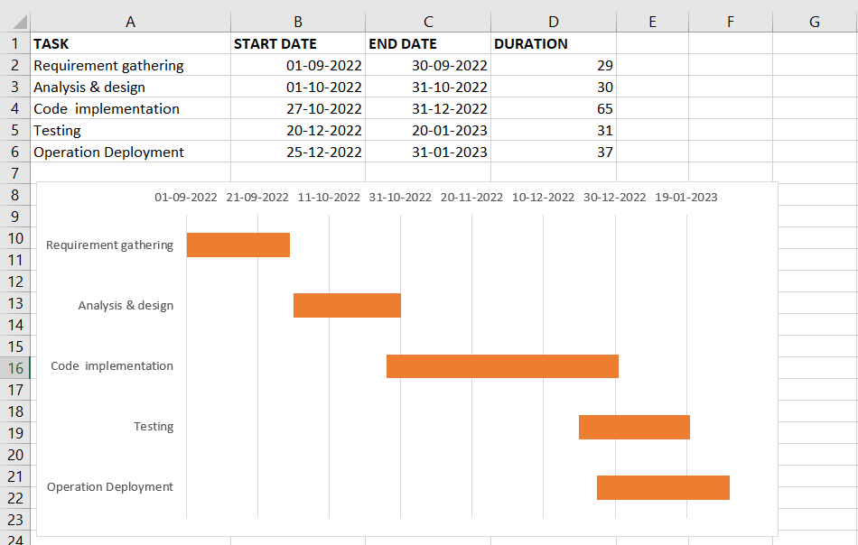
Schedule using gantt chart

Slide 19
Acceptance Criteria
Slot Allocation
Vehicle Tracking
Vehicle Details
Parking Access

Slide 20
Budget
Using COCOMO model
1. Calculate effort
Effort = a(KLOC)*b
Effort = 2.4 (3)*1.05
Effort = 7.56
2. Calculate Time
Time = c(Effort)*d
Time = 2.5 (4)*0.38
Time = 3.8
3. Person Required
Person Required = Effort/Time Person Required = 4 / 3.8
Person Required 1.05
4. Cost of Project Cost = Assumed salary * Person Required
Cost = 10,000.

Slide 21
Requirement analysis
User friendly interface
Availability
Flexibility
Integrity
Scalability
Budget Friendly

Slide 22
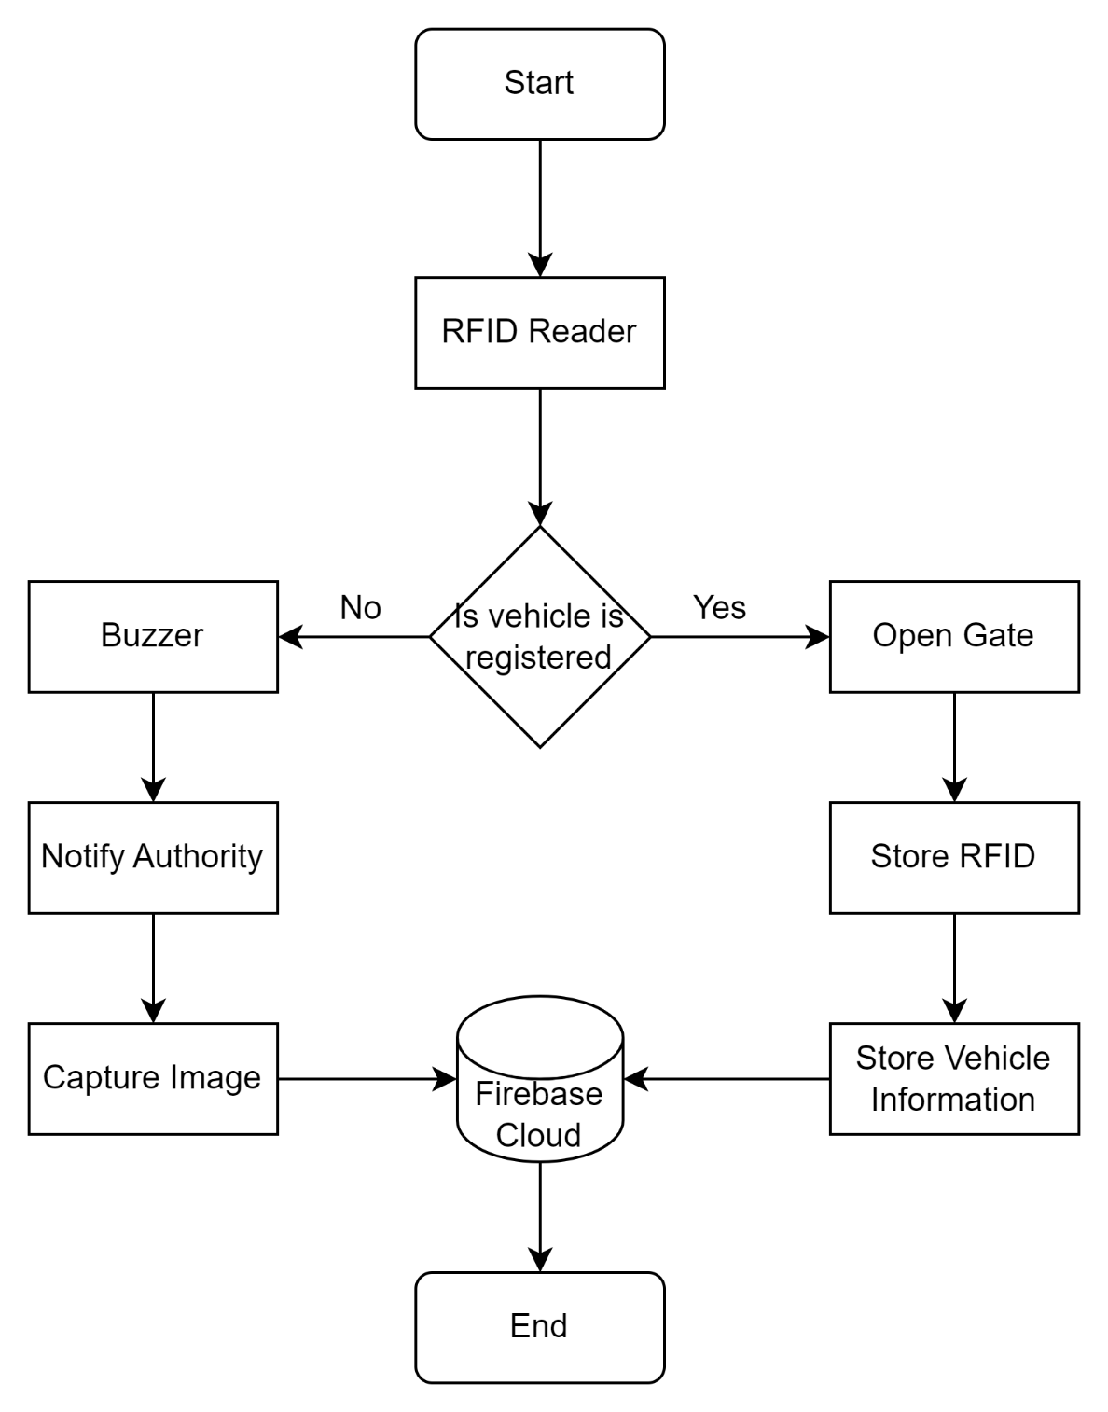
Architecture Diagram

Slide 23
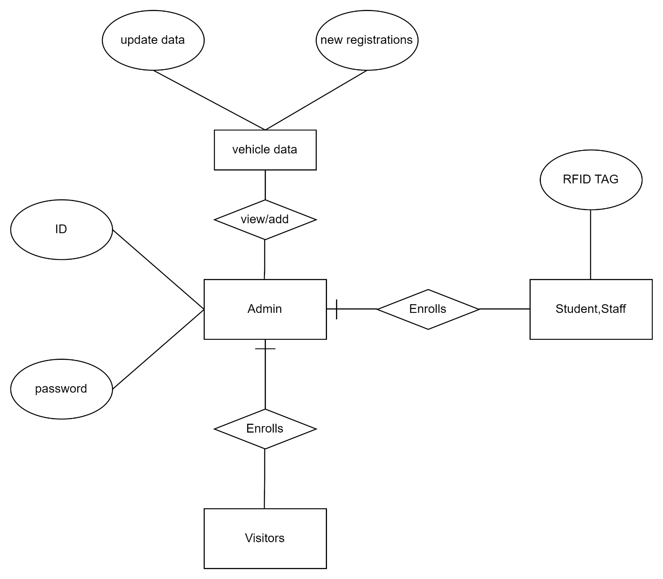
ER diagram

Slide 24
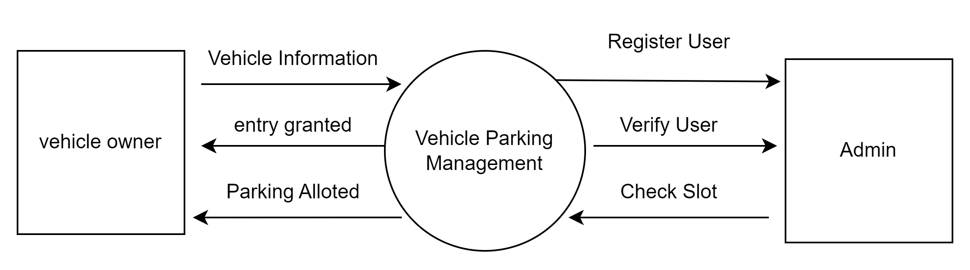
Data Flow Diagram
Level zero DFD

Slide 25
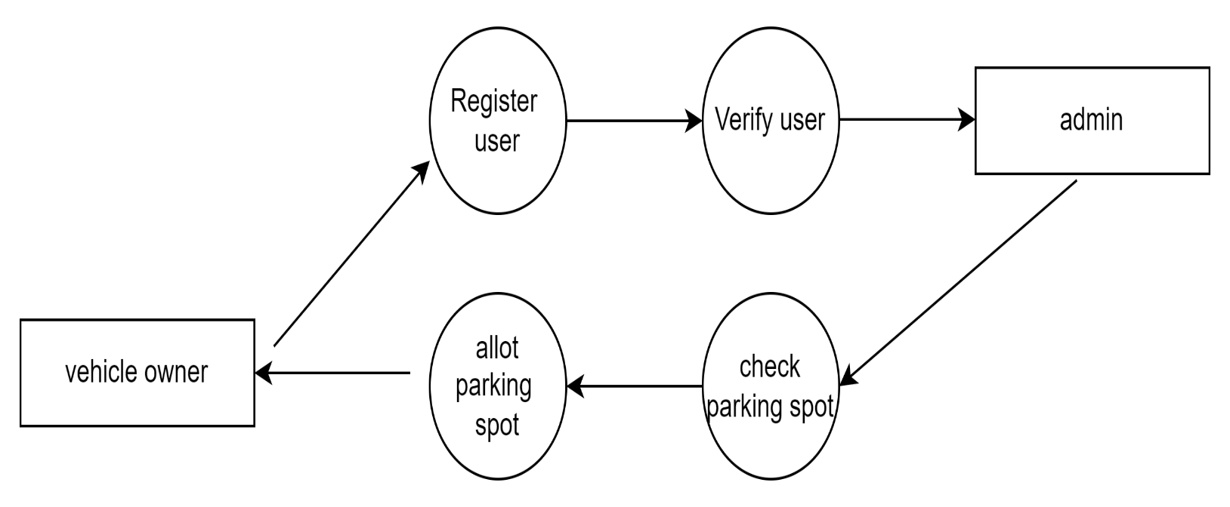
Data Flow Diagram
Level First DFD

Slide 26
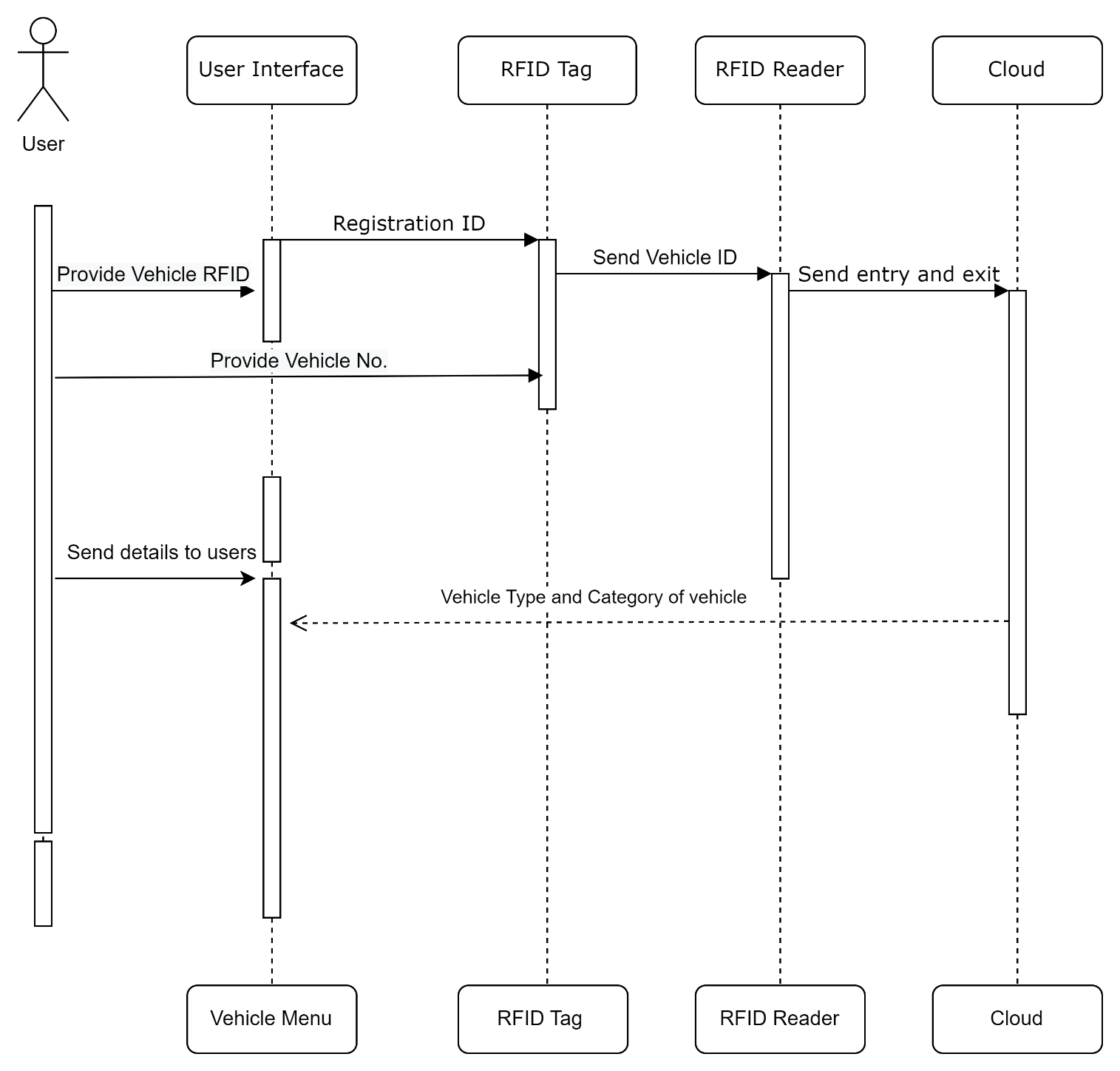
Sequence Diagram

Slide 27
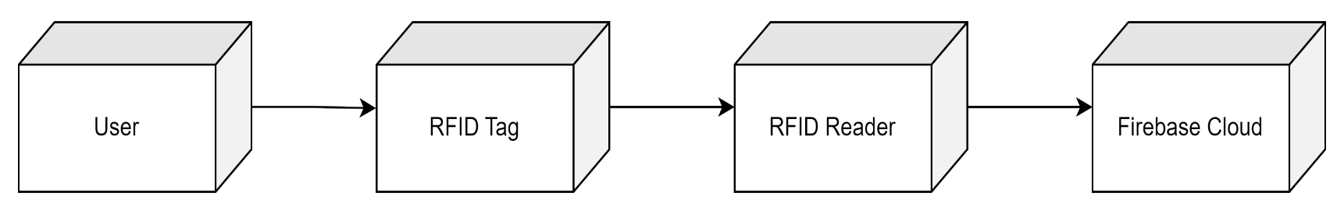
Deployment Diagram

Slide 28
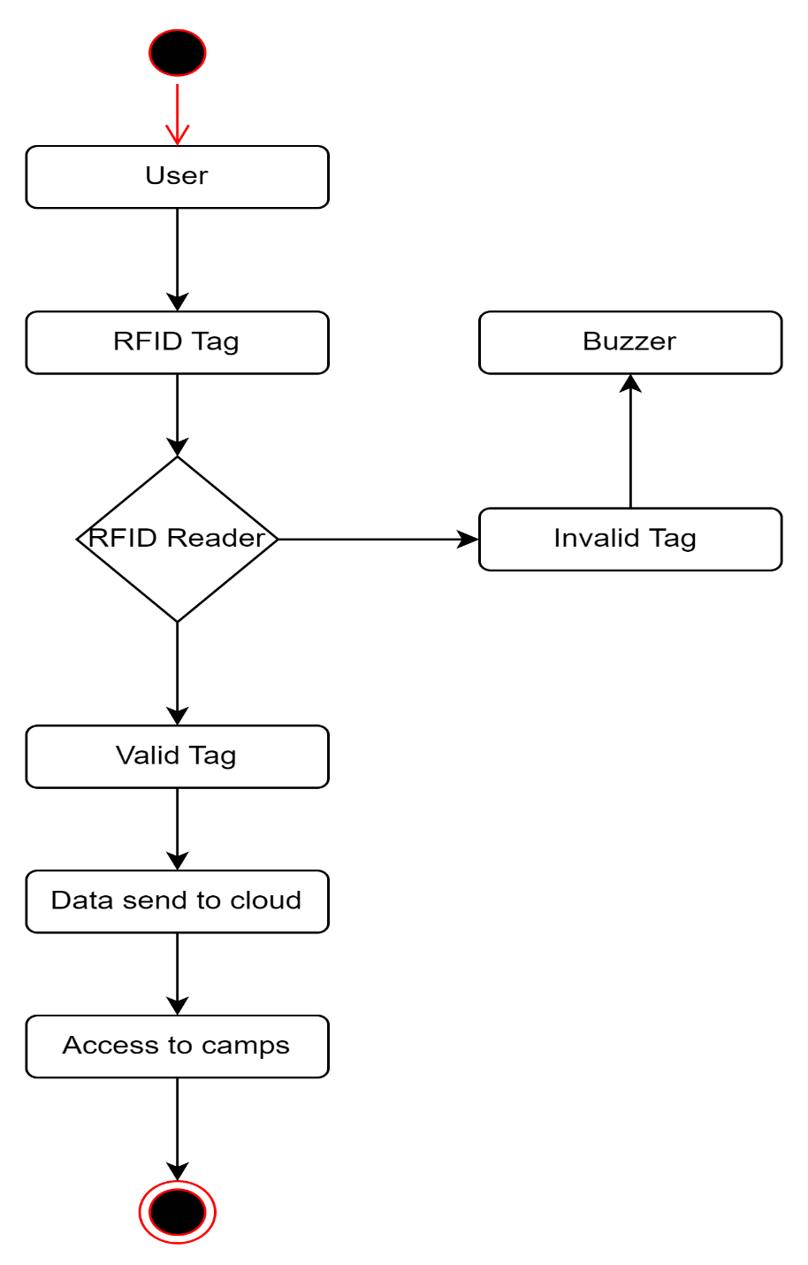
Activity Diagram

Slide 29
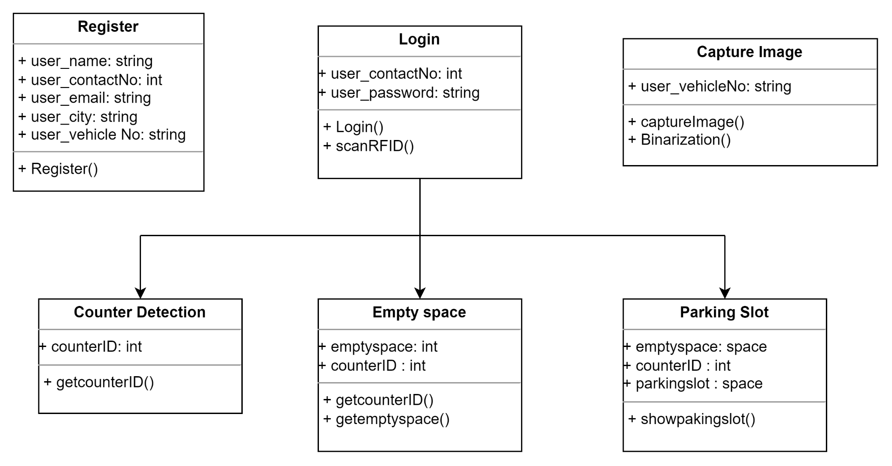
Class Diagram

Slide 30
Algorithms
A decision tree is a non-parametric supervised learning algorithm, which is utilized for both classification and regression tasks. It has a hierarchical, tree structure, which consists of a root node, branches, internal nodes and leaf nodes.
Decision tree learning employs a divide and conquer strategy by conducting a greedy search to identify the optimal split points within a tree. This process of splitting is then repeated in a top-down, recursive manner until all, or the majority of records have been classified under specific class labels. Whether or not all data points are classified as homogenous sets is largely dependent on the complexity of the decision tree.

Slide 31
Algorithms
When it comes to parking, authorities can use this application by installing a system of surveillance cameras in parking lots by using machine vision. These cameras can collect information on parked cars and empty parking bays. Machine vision is also useful for detecting vehicle is park or not in parking slot.

Slide 32
Advantages
Our project provide more in-depth management information .
Saving time and money through automation.
Exact count of parking slots that are available.
Tracking of vehicle data that are entering and leaving the campus which will provide security

Slide 33
Limitations
As we are using cheap RFID reader, so the range of RFID reader is short.
RFID tags falling of from vehicles can cause his entry to be denied.
RFID tags collision happens when two or more tags reflects their signals to the reader at the same time.

Slide 34
Stakeholders
Stakeholders are individuals or groups of people within an organization who have a vested interest in an implementation software project’s outcome and/or whose support is required to launch such a project, drive it forward to a successful conclusion and ensure that the product is utilized to its fullest extent. Following are the stakeholders of our project
Teaching, non-teaching staff and faculty : Staff is responsible for overall filling of data and is one of the important user of the website. As all the entries regarding to the curriculum will be filled by them.
Students and parents: Students are the most important stakeholders; quality of the academic staff and study programs are the most important elements in ensuring quality of higher education and student are responsible for taking the usage of this system and website for their educational purpose.

Slide 35
Conclusion
The work was aimed at proposing efficient, fast, simple and hardware friendly vehicle Number plate recognition system. The two modules of the project namely number plate recognition system (NPRS) and Radio Frequency Identification (RFID) have been individually gathered. Both the modules working parallel. Due to its expansive application area, both academic and commercial world’s number plate recognition systems have received more attention. Induced in an authentic time NPRS implementation techniques and algorithms for exploring possible. There are different ways to achieve results even if, at the time of execution of the selection algorithm plays a supreme role. On the consequence, some image enhancement, optimization and segmentation approaches were used through the experiments. NPR vehicle identification system very fast and accurate results can create.

Slide 36
References
B.Waraich, RFID-Based Automated Vehicle parking system.
P Joshi, M.R Khan and L Motiwalla, Global Review of Parking Management System and Strategies. Volume 2, Issue 6, June-2011 1 ISSN 2279-5141.
Duan, T. D., Du, T. H., Phuoc, T. V., & Hoang, N. V. (2005, February). Building an automatic vehicle license plate recognition system. In Proc. Int. Conf. Comput. Sci. RIVF.
D. Henrici, RFID Security and Privacy: Concepts, Protocols, and Architectures. Springer Science Business Media, 2008, pp. 9-15. [2] F. N. R. Center, Introduction to the rfid.
A.A Kamble and A Dehankar Review on Automatic Car Parking Indicator System, InTernational Journal on recent and innovation trends in computing and communication, Vol 3 no.4 pp 2158-2161.
K Sushma,P Raveendra Babu and J.Nageshwara Reddy, Reservation Based Vehicle Parking System using GSM and RFID Technology, International Journal of Engineering Research and Applications

Slide 37
THANK YOU!!

Slide 38
Mathematical Model
i = {i1,i2,i3…in}
Where I is set of inputs
i1 = Vehicle Registration
i2 = User login
i3 = Capture Image
F = {F1,F2,F3…Fn}
Where F is set of function
F1 = collecting vehicle information
F2 = Register RFID
F3 = Register vehicle on cloud
F4 = Scan RFID
F5 = Image binarization
F6 = Counter detection
F7 = Empty space detection
O = {O1,O2,O3…On}
O1 = Upload data on cloud
O2 = Show parking slot

Slide 39
Functional Requirement
Register of New user.
Firebase cloud connectivity.
Scan RFID get vehicle information retrieve information.
Get data of vehicle information get in/out time counter detection and empty space detection.
If vehicle doesn’t have a RFID Tag then buzzer will be active automatically.

Slide 40
Development Model
The Process model used in our project “Vehicle Parking Management System ” is Agile model.
Agile model believes that every project needs to be handled differently and the existing methods need to be tailored to best suit the project requirements. In Agile, the tasks are divided to time boxes (small time frames) to deliver specific features for a release.

Slide 41
Development Model
Agile Module:
Requirements gathering
Design the requirements
Construction/ iteration
Testing/ Quality assurance
Deployment
Feedback

Slide 42
Data Object and their classes

Slide 43
Modules and their interfaces

